Slide 1

Part 3: NETPIE SmartFarm
by NETPIE.io
Customized/presented by Dr.Varodom Toochinda, Nov 7, 2018

Slide 2
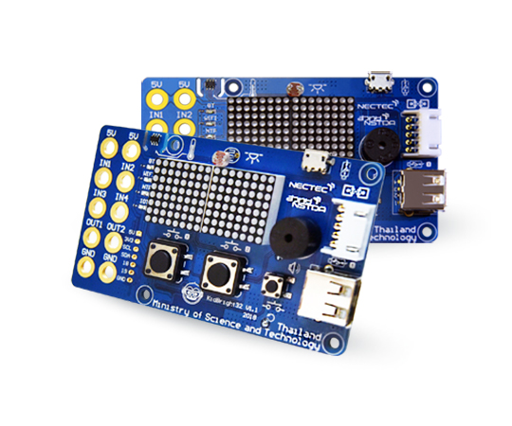
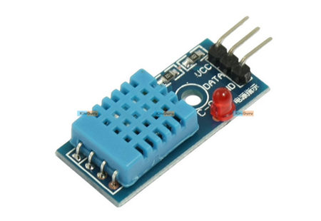
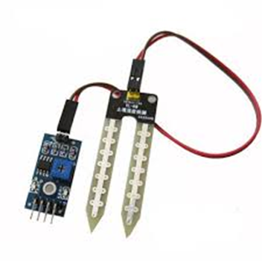
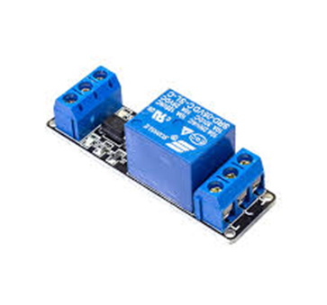
Device Introduction​
https://www.kid-bright.org/
DHT11 Temp&Humid Sensor
Moisture Sensor
Relay

Slide 3
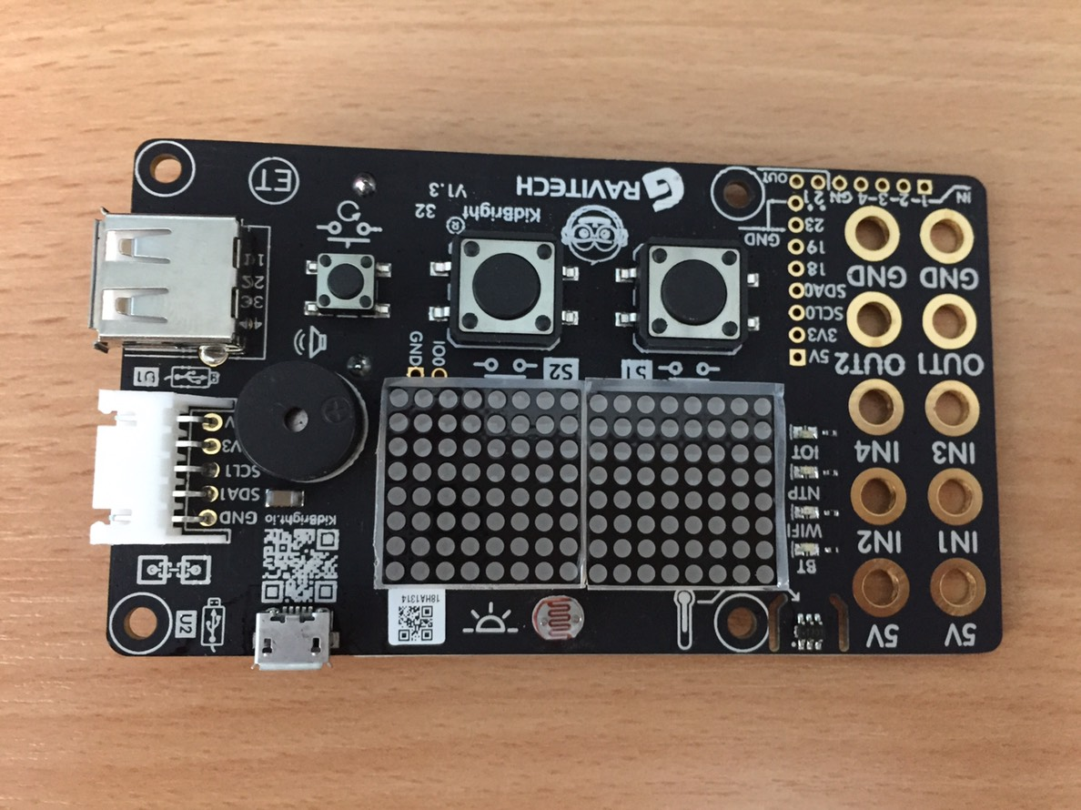

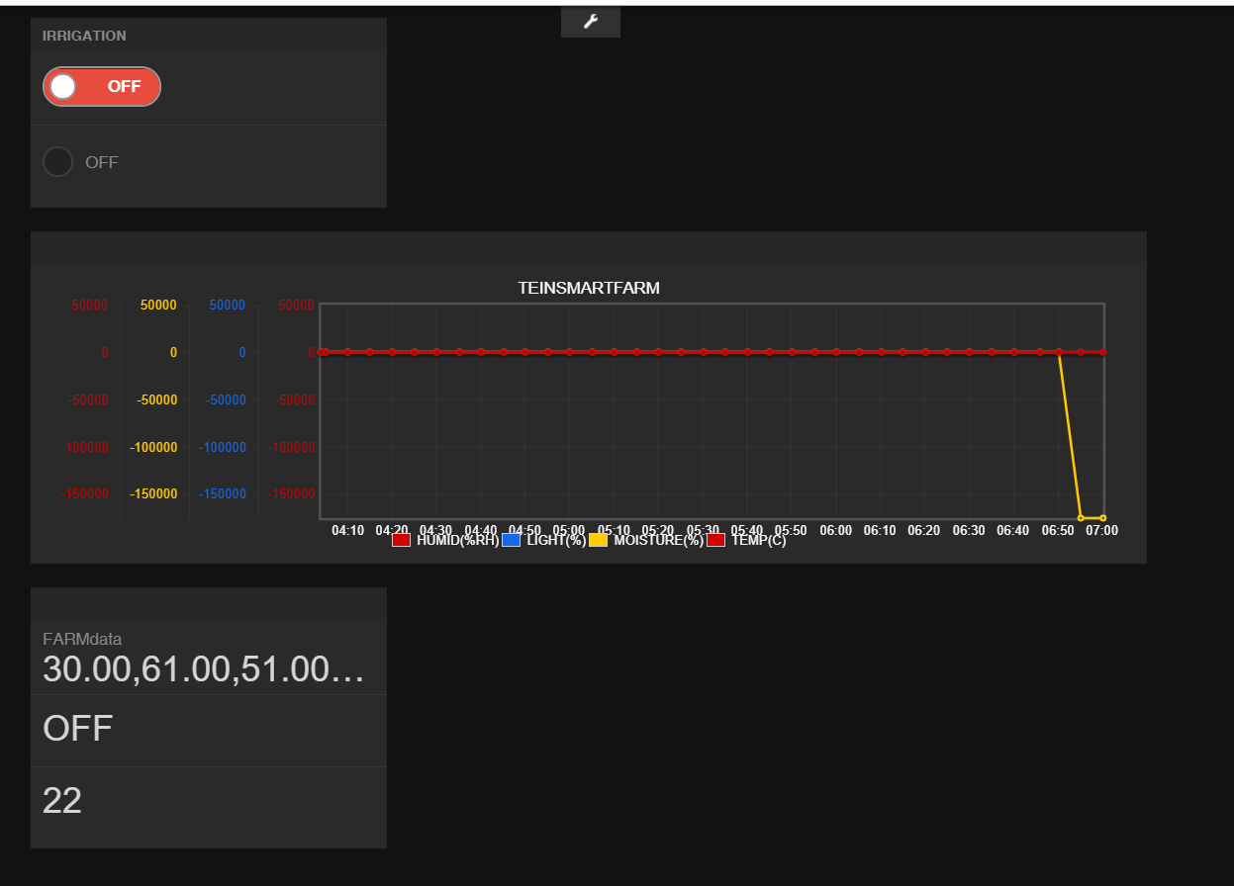
SmartFarm ->Irrigation Management System(IMS)
Input: Temp Hum Moisture
Temp >30 %
Hum < 70 %
Light > 70%
Moisture < 50%

Slide 4
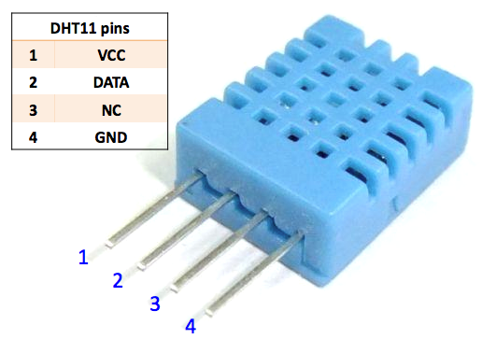

DHT Moisture Relay
Vcc : 5 V
Data : GPIO19
GND
DC+ : 5 V
DV-: OUT1
Vcc : 5 V
Data : GPIO39
GND

Slide 5
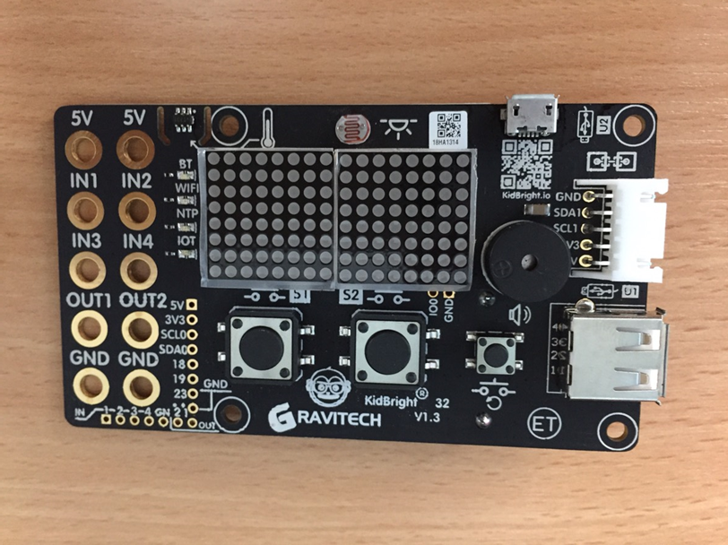
Read Temp Moisture and Light function
void MeasureTempLightMoisture(){
// while(1){
matrix.setTextSize(1);
matrix.setTextWrap(false); // we dont want text to wrap so it scrolls nicely
matrix.setTextColor(LED_ON);
matrix.setRotation(1);
float temp = readTemperature();
Serial.print("Temp:");Serial.println(temp);
///Read light ///////////////////////////////
long analog_value = analogRead(36);
Serial.print("Light:");Serial.println(analog_value);
if(analog_value > 1000){
analog_value = 1000;
}
float ll = (1000 - analog_value)*100/1000;
currentLight =ll;
//Read Moisture
analog_value = analogRead(39);
Serial.print("Moisture:");Serial.println(analog_value);
//analog_value = analog_value*3600/4095;
//MT=0% analog_value = 4095: MT=100% analog_value = 1000
float moisture= 132-132*1000*analog_value/3095;
currentMoisture = moisture;

Slide 6
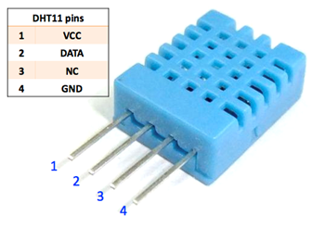
Read DHT11 Temp and Humid
void MeasureDHTTempMoisture(){
humid = dht.readHumidity(); // อ่านค่าความชื้น
temp = dht.readTemperature(); // อ่านค่าอุณหภูมิ
lastDHTRead = millis();
Serial.print("Humid: "); Serial.print(humid); Serial.print(" %, ");
Serial.print("Temp: "); Serial.print(temp); Serial.println(" °C ");
// ตรวจสอบค่า humid และ temp เป็นตัวเลขหรือไม่
if (isnan(humid) || isnan(temp)) {
Serial.println("Failed to read from DHT sensor!");
// netpieshow("DHT sensor ERROR...");
}
else{
// เตรียมสตริงในรูปแบบ "{humid},{temp}"
String datastring = (String)humid+","+(String)temp;
currentTemp = (int)temp;
currentHumid = (int)humid;
}

Slide 7
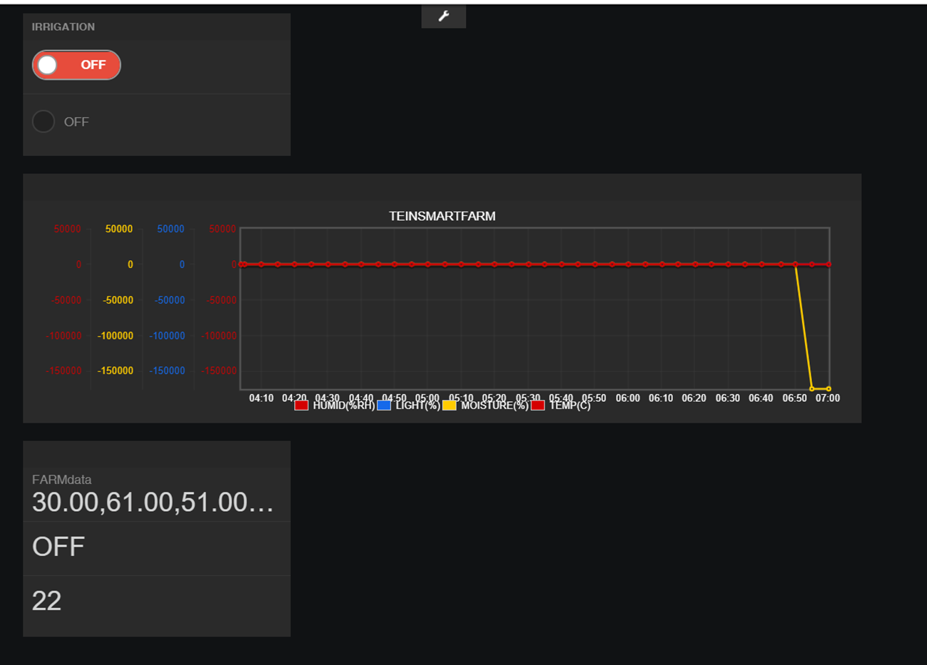
IRRIGATION
void irrigation()
{
if ((currentMoisture < 50)&&(currentLight > 90)&&(currentTemp > 30)&&(currentHumid < 70))
{
microgear.publish(IRRIDATATOPIC,"ON");
delay(100);
String notificationtext= "Moisture low..."+String(currentMoisture)+ "% irrigate now..";
///Send notification to USER
microgear.publish("/@push/owner",notificationtext);
}
//else { if ((currentMoisture < 50)) netpieshow("Moisture LOW");}
String farmdata = String(currentTemp)+","+String(currentHumid)+","+String(currentLight)+","+String(currentMoisture);
microgear.publish(SMARTFARMDATATOPIC,farmdata);
Serial.print("Temp:");Serial.println(currentTemp);
Serial.print("Humid:");Serial.println(currentHumid);
Serial.print("Light:");Serial.println(currentLight);
Serial.print("Moisture:");Serial.println(currentMoisture);
}

Slide 8
onMsghandler
void onMsghandler(char *topic, uint8_t* msg, unsigned int msglen) {
Serial.print("Incoming message --> ");
msg[msglen] = '\0';
Serial.println((char *)msg);
if (*(char *)msg == '0') updateLED(0);
else if (*(char *)msg == '1') updateLED(1);
char strState[msglen];
for (int i = 0; i < msglen; i++) {
strState[i] = (char)msg[i];
Serial.print((char)msg[i]);
}
Serial.println();
stateStr = String(strState).substring(0, msglen);
Serial.println(stateStr);
if (stateStr == "ON") updateRELAY(0);
else if (stateStr == "OFF") updateRELAY(1);
}

Slide 9
SmartFarm FREEBOARD

Slide 10
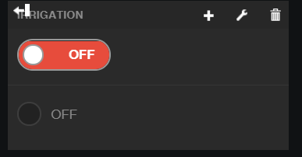
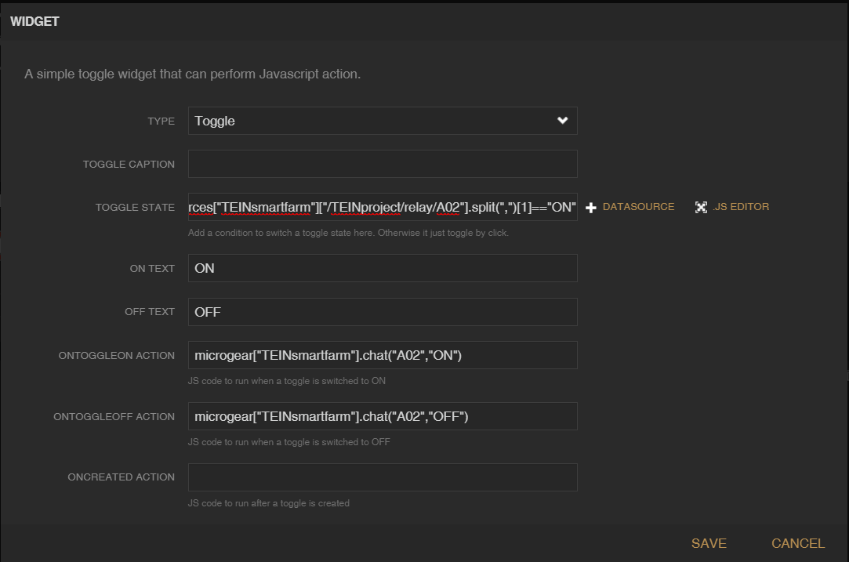
Toggle Switch

Slide 11

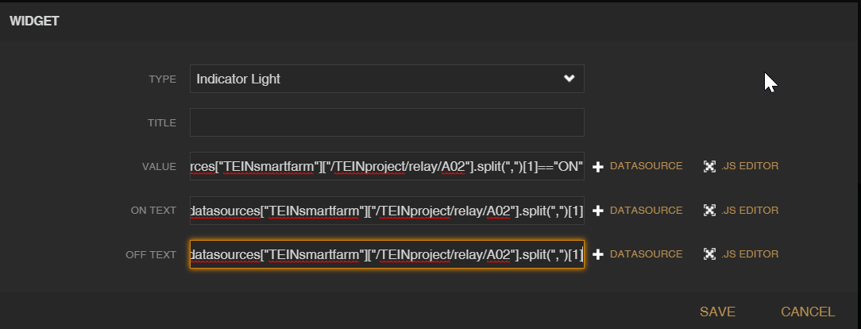
Indicator Light

Slide 12
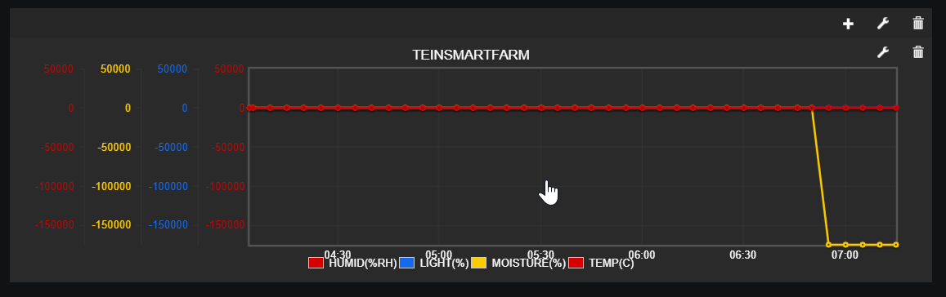
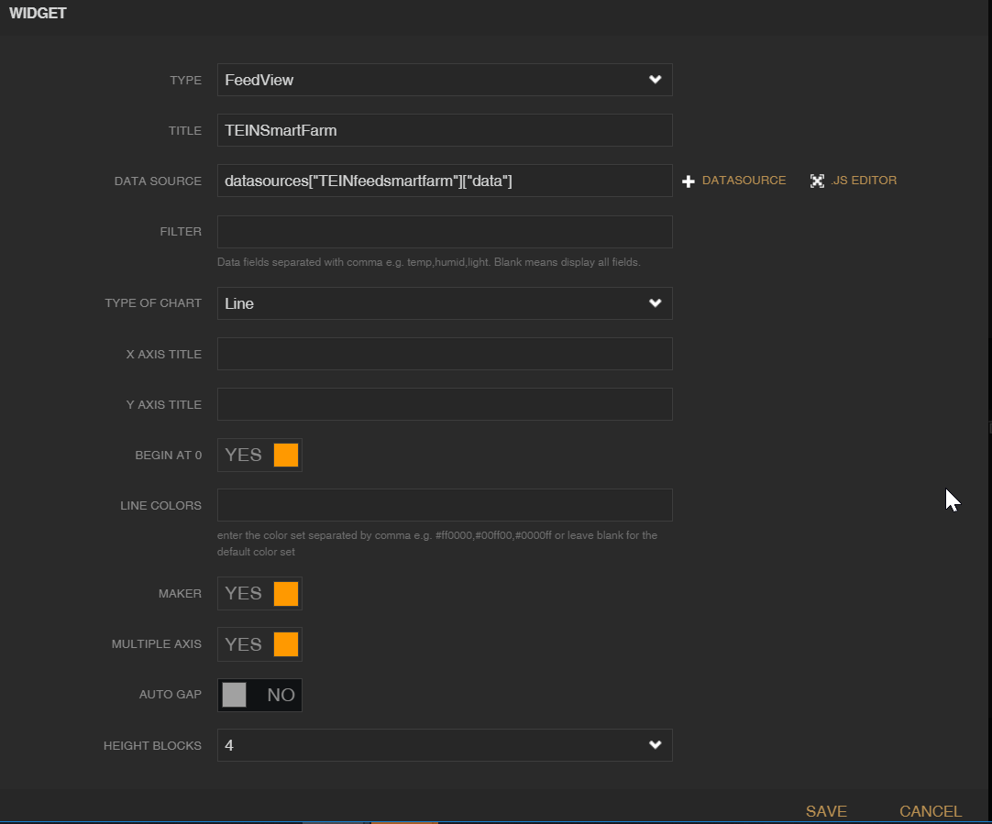
FeedView

Slide 13
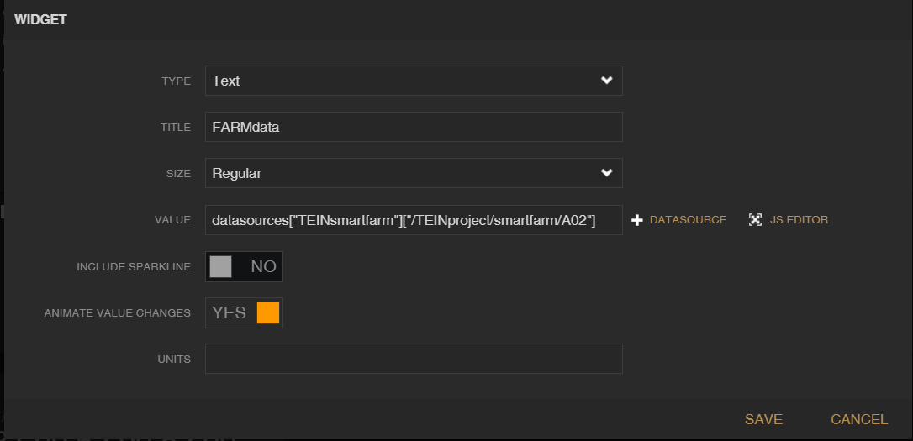
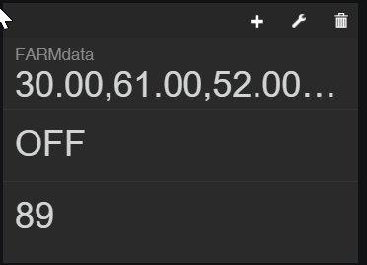
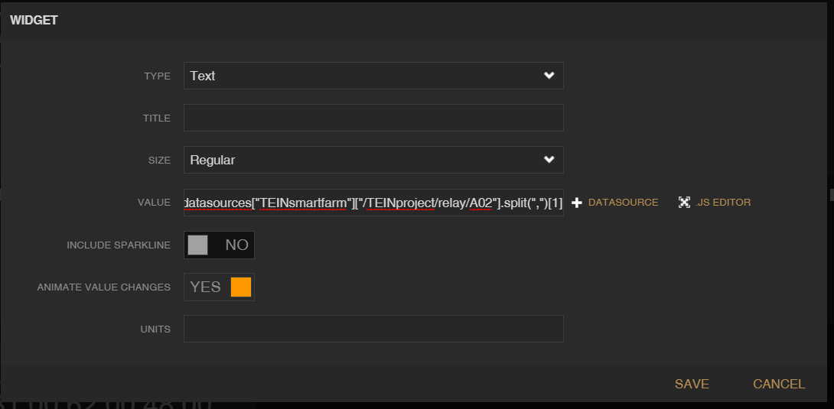
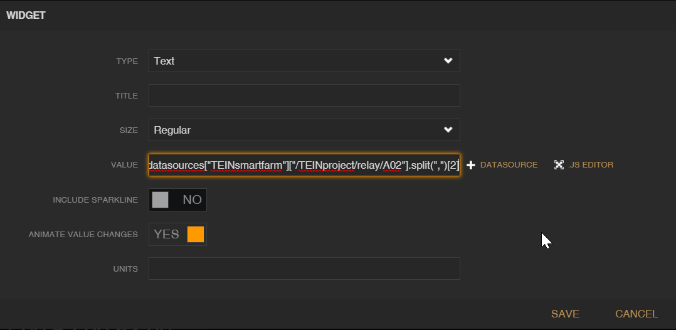
Text

